Slide 1
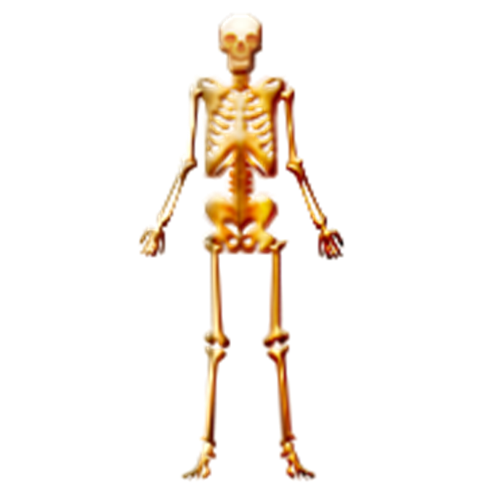
Anatomical Language and Body Planes
Dr. Jennifer Lucy

Slide 3
Anatomical Position
Body erect,
feet slightly apart,
palms facing forward,
thumbs point away
from the body

Slide 4
Directional Terms
Superior (Cranial) &Inferior (Caudal) – towards and away from the head or upper part of a structure - above and below-
Anterior (Ventral) and Posterior (Dorsal) – toward the front and back of the body- in front of and behind-
Medial, Lateral, and Intermediate – toward the midline, away from the midline, and between a more medial and lateral structure

Slide 5
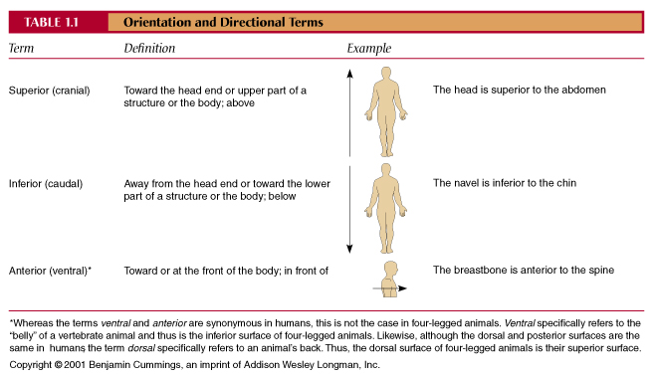

Slide 8
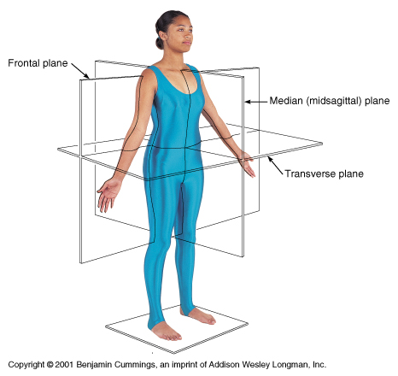
Body Planes
Sagittal and Medial – divides the body into right and left parts
Midsagittal – sagittal plane that lies on the midline
Frontal or Coronal – divides the body into anterior and posterior parts
Transverse or horizontal (cross section) – divides the body into superior and inferior parts

Slide 9
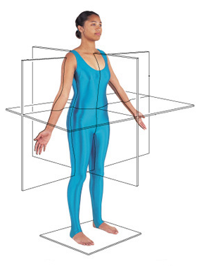
Body Planes
Frontal or Coronal Plane
←Transverse Plane
← Sagittal Plane

Slide 10
BODY CAVITIES
Overview

Slide 11
Body Cavities
Dorsal cavity :
protects the nervous system, and is divided into two subdivisions
Cranial cavity is within the skull and encases the brain
Vertebral cavity runs within the vertebral column and encases the spinal cord
Ventral cavity:
houses the internal organs (viscera), and is divided into two subdivisions: thoracic and abdominopelvic

Slide 12
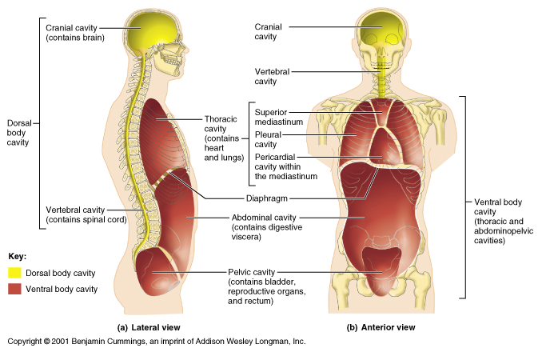

Slide 13
Body Cavities
Thoracic cavity is subdivided into pleural cavities, the mediastinum, and the pericardial cavity
Pleural cavities – each houses a lung
Mediastinum – contains the pericardial cavity, and surrounds the remaining thoracic organs
Pericardial – encloses the heart

Slide 14
Body Cavities
The abdominopelvic cavity is separated from the superior thoracic cavity by the dome-shaped diaphragm
It is composed of two subdivisions
Abdominal cavity – contains the stomach, intestines, spleen, liver, and other organs
Pelvic cavity – lies within the pelvis and contains the bladder, reproductive organs, and rectum

Slide 15
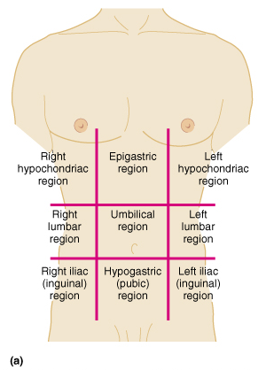
Abdominopelvic Regions
Umbilical
Epigastric
Hypogastric
Right and left iliac or inguinal
Right and left lumbar
Right and left hypochondriac

Slide 16
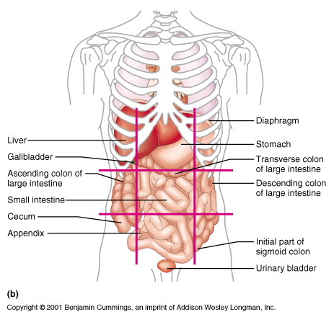
Abdominopelvic Regions

Slide 17
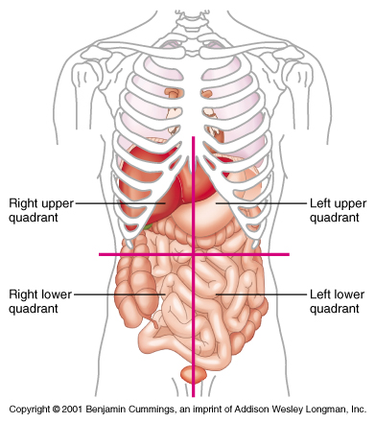
Abdominopelvic Quadrants
Right upper quadrant
Left upper quadrant
Right lower quadrant
Left lower quadrant

Slide 18
Directional Terms
PROXIMAL

Slide 19
Towards the point of origin

Slide 20
DISTAL

Slide 21
Away from or furthest from the point of origin

Slide 22
The wrist is more_______________ to the shoulder that the elbow

Slide 23
Lateral
Lateral

Slide 24
Away form the midline of the body

Slide 25
Medial

Slide 26
The spinal column is ___________________ to either shoulder blade.

Slide 27
Inferior

Slide 28
Away from the head/ below

Slide 29
Superior

Slide 30
Towards the head end of the body /above

Slide 31
The neck is ________________-to the waist

Slide 32
The anatomical words for front are :

Slide 33
VENTRAL and ANTERIOR

Slide 34
The medical term for the back are……

Slide 35
DORSAL and POSTERIOR

Slide 36
The trachea is ___________________to the esophagus

Slide 37
What is the term for between two structures?

Slide 38
INTERMEDIATE

Slide 39
The index finger is ______________to the thumb and middle finger

