Slide 1
Vision Testing

Slide 2
Far Vision
A comprehensive examination will include a vision test.
For far distance vision a common test is the Snellen chart
There are several versions for adults and children
Explain to patient the procedure. This includes:
Where to stand ( at 20 feet)
If they need to remove their contacts or glasses
Not to squint during the test

Slide 3
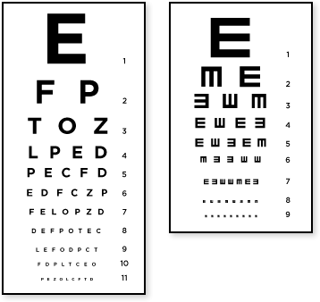
Adult Snellen Tumbling E

Slide 4
Tumbling E Chart
In some cases a standard Snellen eye chart cannot be used
the person having the eye test is a young child who doesn't know the alphabet
Person is illiterate or has a handicap that makes it impossible for him to cognitively recognize letters or read them aloud.
The tumbling E chart has the same scale as a standard Snellen eye chart, but all characters on the chart are a capital letter "E," in different spatial orientations (rotated in increments of 90 degrees).
The eye doctor asks the person being tested to use either hand (with their fingers extended) to show which direction the "fingers" of the E are pointing: right, left, up or down.
Studies have shown that visual acuity measurements using a tumbling E chart are virtually the same as those obtained from testing with a standard Snellen eye chart.

Slide 5
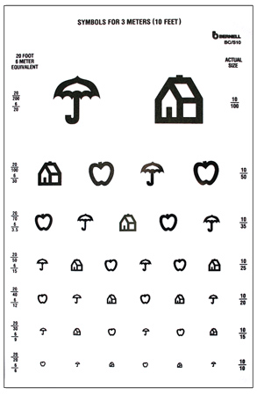
Pediatric Snellen
Used for young children who do not know the alphabet

Slide 6
Near Vision
Jaeger tests are common
Hold chart 14-16 inches
from head

Slide 7
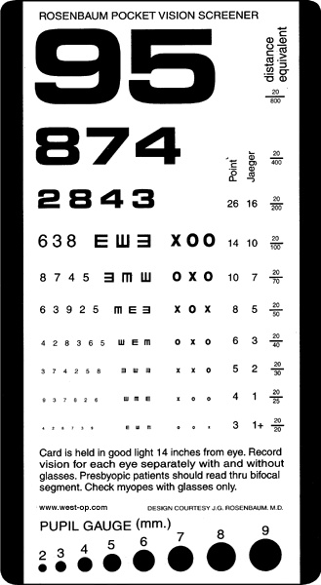
Rosenbaum Near Vision
Rosenbaum tests are common
Hold chart 14-16 inches
from head

Slide 8
Ishahara Color Blindness Test
The Ishihara test is a color perception test for red-green color deficiencies, the first in a class of successful color vision tests called pseudo-isochromatic plates ("PIP"). It was named after its designer, Dr. Shinobu Ishihara, a professor at the University of Tokyo, who first published his tests in 1917.
The test consists of a number of colored plates, called Ishihara plates, each of which contains a circle of dots appearing randomized in color and size.
] Within the pattern are dots which form a number or shape clearly visible to those with normal color vision, and invisible, or difficult to see, to those with a red-green color vision defect.
Other plates are intentionally designed to reveal numbers only to those with a red/green color vision deficiency, and be invisible to those with normal red/green color vision.

Slide 9
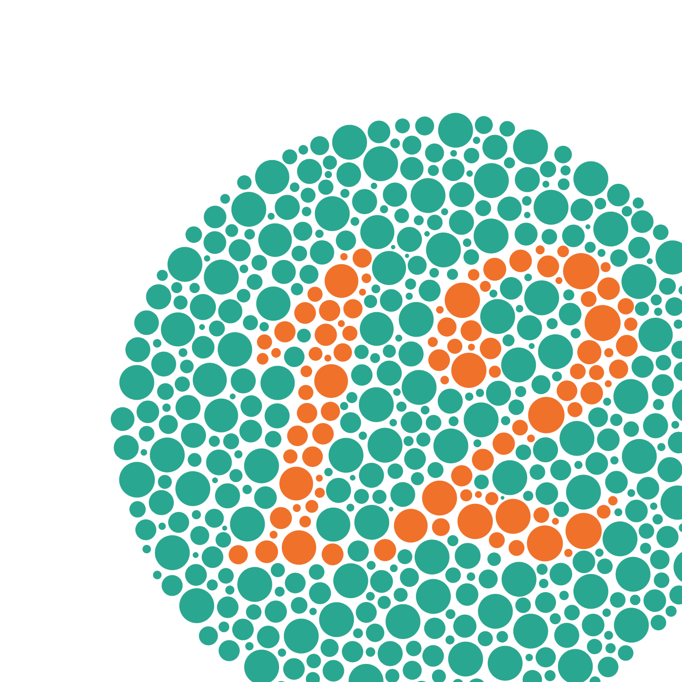
Directions
Hold book at reading level and have patient do each plate individually.
Mark on report if patient can read the number

