Slide 1
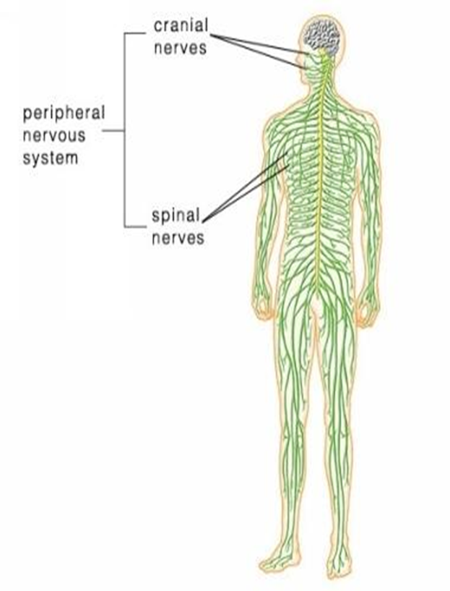
The Peripheral Nervous System

Slide 2
Peripheral Nervous System
consists of the nerves that branch out from the CNS and connect it to other body parts, also includes the cranial nerves
12 pairs cranial nerves
31 pairs spinal nerves
Divided into two categories:
Afferent (Sensory) neurons convey messages to the brain and spinal cord
Efferent ( Motor) neurons convey messages from brain and spinal cord to muscles and glands

Slide 3
Efferent System
Somatic: controls voluntary movements e.g skeletal muscles and conscious activities
Autonomic: Maintains balance of involuntary bodily functions and allows body to react in emergencies

Slide 4
Peripheral Nervous System
The spinal nerves comes out of the spine, and the cranial nerves come out of the brain directly.
There are 12 pairs of cranial nerves
They are numbered with Roman numerals.

Slide 5
The 12 Pairs of Cranial Nerves

Slide 6
I. OLFACTORY
Transmit the sense of smell. Outside of the CNS they are called olfactory nerves, and inside of the CNS they are called the olfactory tract.
Test patients sense of smell

Slide 7
II. OPTIC NERVE
Transmits information from the eye’s retina.
Patient covers one eye: you cover same side
Wiggle movement in from side
Have person cover eye at 18 inches
and read two sentences

Slide 8
III. Occulomotor Nerve
This controls most of the extrinsic muscles of the eye (that move the eyelids).
Shine pen light into patients eye
At 8”.
Pupil should constrict immediately

Slide 9
IV. Trochlear Nerve
Innervates an extrinsic eye muscle
( gives nerve supply to)
Ask patient to follow as you move
Your arm up and down without
Moving head.

Slide 10
V. Trigeminal Nerve
This is the main sensory nerve of the face. It has a large branch that passes through the foramen ovale of the skull. It has three parts.
Motor: Assess masseter and temple muscles.
Touch jaw: have patient clench teeth
Sensory: Close eyes :Apply cotton ball to forehead & jaw. Have them tell you when they feel it

Slide 11
VI: Abducens
Controls one of the eye muscles (lateral rectus)
Have patient follow finger from side to side without
Moving head.

Slide 12
VII. Facial Nerve
This innervates the muscles of facial expression.
A person who cannot blink or smile may have damage to this nerve.
BELL’S PALSY is damage of the facial nerve causing paralysis on one side.
Have patient smile, frown, raise
eyebrows and puff out cheeks

Slide 13
VIII. VESTIBULOCOCHLEAR
Transmits hearing and balance. (also called Auditory nerve)
Stand 2 ft away whisper a number
As you move towards person
Balance: Spin person 10 times then
Stop: Check for dizziness
Should resolve quickly

Slide 14
IX. GLOSSOPHARYNGEAL
carries information from the head and neck to the brainstem.
Information about blood pressure (baroreceptors)
Hold down tongue: Check
Uvula: Say AHH

Slide 15
X. Vagus Nerve
(vagrant“wanders”) - the only cranial nerve that travels into the abdomen.
This is the most important cranial nerve because it innervates all of the organs in the thoracic and abdominal cavities
Put hand on patients throat: Have him swallow

Slide 16
XI. ACCESSORY NERVE
Enters the skull through foramen magnum and leaves through the jugular foramen.
It just supplies the shoulder muscles.
Have patient shrug shoulders
Turn head side to side

Slide 17
XII. HYPOGLOSSAL NERVE
Supplies the tongue.
Damage causes impairment of speech.
Observe symmetry from midline
Move tongue against force
of depressor side to side

Slide 18
I. Olfactory | sense of smell
II. Optic | sight
III. Occulomotor | move eyelids
IV. Trochlear | move eyes
V. Trigeminal | face, jaw, chewing
VI. Abducens | eyes
VII. Facial | facial expressions
VIII. Vestibulocochlear (Auditory) | sense of equilibrium, hearing

Slide 19
IX. Glossopharyngeal | pharynx, tongue
X. Vagus | major organs, viscera
XI. Accessory | shoulders
XII. Hypoglossal | tongue

Slide 20
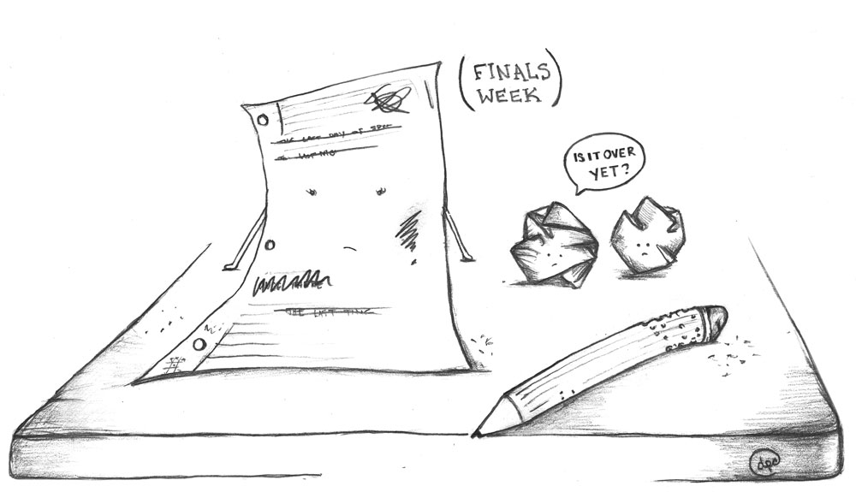
Need to know all of the cranial nerves ? Come up with your own Mnemonic Device!!!!!!!!!!!
Oh Once One Takes The Anatomy Final Very Good Vacations Are Heavenly

Slide 22
Spinal Nerves
Originate in Spinal Cord
Exit through opening in vertebrae

Slide 23
Each nerve connects to the spinal cord two attachments called ROOTS
Dorsal / Posterior Root ( Sensory to brain) Anterior/ Ventral root( Motor away from brain)

Slide 24
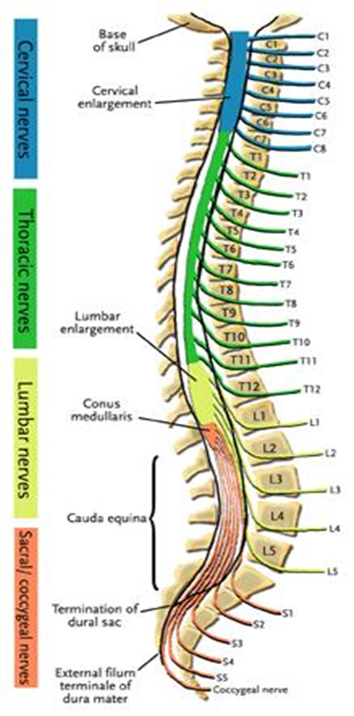
8 pairs of cervical nerves (C1 - C8) 12 pairs of thoracic nerves (T1-T12) 5 pairs of lumbar nerves (L1-L5) 5 pairs of sacral nerves (S1-S5) 1 pair of coccygeal nerves (Co)
31 Total

Slide 25
PLEXUSES
Main portions of the spinal nerves combine to form complex networks called PLEXUSES

Slide 26
1. Cervical Plexuses - neck
2. Brachial Plexus - shoulders, arms, hands
Ulnar
Median
Radial
axillary nerves
3. Lumbrosacral Plexuses - pelvic area
Sciatic nerve ( longest nerve)
Femoral nerve

Slide 27
*Spinal cords ends at the level between the 1st and 2nd lumbar vertebrae
*The lumbar, sacral, coccygeal nerves descend from the end of the cord – CAUDA EQUINA (horse’s tail)

Slide 29
AUTONOMIC NERVOUS SYSTEM
Sympathetic (fight or flight)
Parasympathetic (rest and digest)

Slide 30
Sympathetic – Sends message to adrenal medulla to secret hormones to prepare body for action (Fight or Flight )
Parasympathetic –( Rest and Digest)
Counteracts the effects of the Sympathetic Nervous System
Divisions act antagonistically

