Slide 1
Personality and Professional Qualities of a Health Care Worker
Within 20 seconds to 4 minutes people form an impression about another person based mainly on appearance!

Slide 2
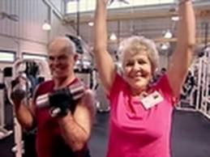
Good Health
Health care involves promoting good health and preventing disease.
One must preach and practice:
Proper Diet
Adequate Rest
Regular Exercise
Good Posture
No alcohol, tobacco or drug use

Slide 3
Professional Appearance
Uniform: should be kept neat, well fitting, clean, and free from wrinkles
Clothing: should allow for freedom of body movement and should be appropriate for the job, and in good conditions.
Name Badge: Always wear if required.
Shoes: should fit well and provide good support.
Low heels only; no sandals or open-toe shoes

Slide 4
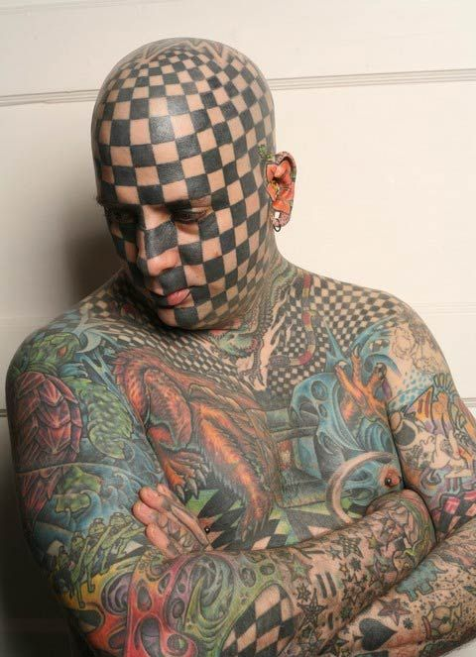
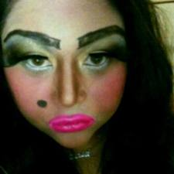
Professional Appearance Cont.
Nails: Should be kept short, clean and natural
Hair: clean, neat and pulled back
Jewelry: usually not permitted. Transmits germs and pathogens
Makeup/Tattoos: Avoid excessive makeup. NO visible tattoos

Slide 5
Personal Hygiene
Essential
Control body odor
Take bath/showers and brush teeth daily
Wear clean undergarments
Avoid strong perfumes, scented hair sprays and aftershave lotion.
You don’t want to offend anyone

Slide 6
Personal Characteristics
Empathy: understand how the patient feels. Sincerity
Honesty
Dependability
Willingness to Learn
Patience
Acceptance of Criticism
Enthusiasm
Self Motivation
Tact
Competence
Responsibility
Discretion
Team Player

Slide 7
Effective Communication
Communication: the exchange of information , thoughts, ideas, and feelings
Verbal
Nonverbal
Communication Process
Sender: individual who creates the message
Message: information, ideas or thoughts
Receiver: individual who receives the message

Slide 8
Feedback
Used to determine if the message was successful. Many factors can interfere with effective communication.
The message must be clear
The sender must deliver the message in a clear and concise manner
The reciever must be able to hear and receive the message
The reciever must be able to understand the message
Interruptions and distractions must be avoided

Slide 9
Listening
Paying attention and making an effort to hear what the other person is saying.
Show interest
Don’t interrupt
Be alert
Pay attention
Dismiss prejudices
Eliminate distractions

Slide 10
Barriers to Communication
Physical disabilities
Deafness or Hearing loss
Blindness or impaired Vision
Aphasia/Speech Impairments
Psychological Barriers
Prejudices
Attitudes
Personality
Cultural Diversity
Beliefs and Practices regarding health and illness
Language Differences
Eye Contact
Touch

Slide 11
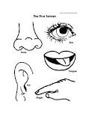
Recording and Reporting
Observation
Sense of Sight
Sense of Smell
Sense of Touch
Sense of Hearing
Subjective Observations
Symptoms
Objective Observations
Signs

Slide 12
Teamwork
All aspects of healthcare working together for the benefit of the patient.
Improves communication and continuity of care
Everyone must understand and the roles of all members of the team
A leader is essential
Interpersonal Relationships
Effective teams are the result of hard work, patience, commitment and practice

Slide 13
Professional Leadership
Leadership is the skill or ability to encourage people to work together and do their best to achieve a common goal.
A leader is an individual who leads or guides others or who is in charge of or in command of others
Democratic Leader- encourages the participation of all individuals in decisions that have to be made or problems that have to be solved
Laissez-faire leader- Informal; believes in non interference in the affairs of others.
Autocratic Leader– Dictator; maintains total rule and makes all decisions

Slide 14
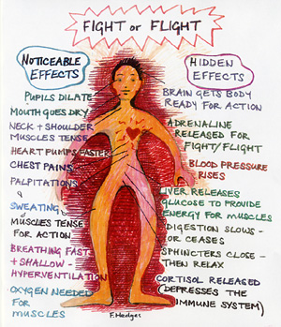
Stress
Stress is defined as the body's reaction to any stimulus that requires a person to adjust to a changing environment.
“Fight or Flight”

Slide 15
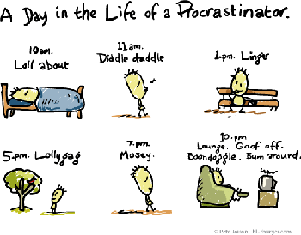
Time Management
Time Management is a system of practical skills that allows an individual to use time in the most effective and productive way possible

Slide 16
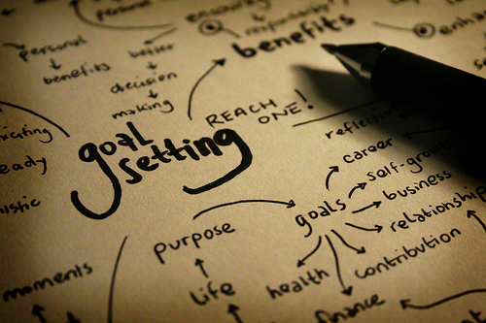
Setting Goals
A goal is a desired result or purpose toward which one is working.
Short Term Goals
Long Term Goals

Slide 17
Time Management Plan
Analyze and Prioritize
Identify Habits and preferences
Make a Daily “to-do” list
Plan your Work
Avoid Distractions
Take Credit for a job well done

