Slide 1
Mindboggling

Slide 2
Visual Imagery (visual cortex)
Visualize a place you’d like to be. Maybe it’s riding a bike, sitting in the park or just hanging out in your bedroom. Create an image of that place and hold it in your mind for a minute.

Slide 3
Auditory Cortex
Listen to the sounds in the room – really listen. What do you hear? Is it the cracking of someone’s gum, a whisper, the hum of the air conditioner? How many sounds can you differentiate?

Slide 4
Cognitive
Starting at 100, count backwards by 7.

Slide 5
Hippocampus
Recall an event from your past, try to remember as many details as you can from it. (Example: the first time you rode a bike, a family holiday). What emotions were you feeling?

Slide 6
Memory
Memorize this list
Candy, Head, Bear, Farm, Ring, Cat, Jennifer, Necklace, Nine, Pen

Slide 7
What were the items on the list?
How can you make it easier to remember a list?

Slide 8
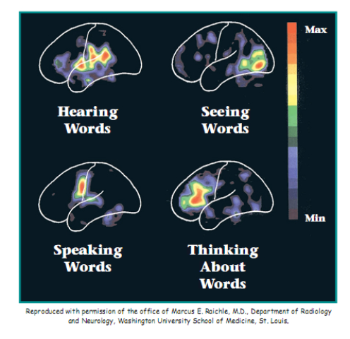
PET SCANS
Positron Emission Tomography

Slide 10
14 or 16? Depends on how you look at it.

Slide 11
List the colors.

Slide 12
Train Your Brain.
Don’t look at the clock, but have you partner watch it. Try to guess how long it takes for 30 seconds to pass. After a few tries you should become more accurate.

Slide 13
Processing Words and Letters
Read the Sentence and count how many letter F's are in it. FINISHED FILES ARE THE RE SULT OF YEARS OF SCIENTI FIC STUDY COMBINED WITH THE EXPERIENCE OF YEARS...

Slide 14
Processing Words and Letters
Read the Sentence and count how many letter F's are in it. - THERE ARE 6 FINISHED FILES ARE THE RE SULT OF YEARS OF SCIENTI FIC STUDY COMBINED WITH THE EXPERIENCE OF YEARS...
Your brain does not process the word "of" when reading sentences.

Slide 15
Brain Teaser – Word Rhymes
Headache = Brain ________
Chief Genius = ________ Brain
Tune you can’t get out of your head = Brain ________
Vehicle that transports cerebrums = Brain ___________
What a neurology professor does = ________ Brains
Not abnormal = _____ Brain

Slide 16
Brain Teaser – Word Rhymes
Headache = Brain Pain
Chief Genius = Main Brain
Tune you can’t get out of your head = Brain Refrain
Vehicle that transports cerebrums = Brain train
What a neurology professor does = Explains Brains
Not abnormal = Sane Brain

Slide 17
Aoccdrnig to rscheearch at Cmabrigde Uinervtisy, it deosn't mttaer in waht oredr the ltteers in a wrod are, the olny iprmoetnt tihng is taht the frist and lsat ltteer be at the rghit pclae. The rset can be a toatl mses and you can sitll raed it wouthit a porbelm. Tihs is bcuseae the huamn mnid deos not raed ervey lteter by istlef, but the wrod as a wlohe.

Slide 18
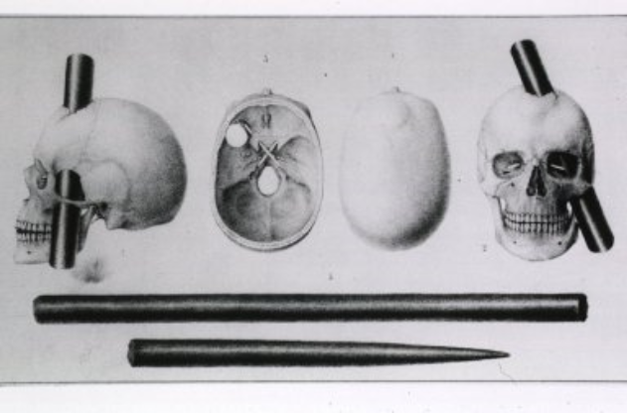
The Curious Case of Phineas Gage

