Slide 1
Microsoft Surface Tablet 3
Chattahoochee High School
Surface Deployment

Slide 2
You are receiving a tablet today because you have fulfilled all of the following requirements:
Got 100% on the online digital citizenship quiz
Signed and returned the device user agreement form
No previous outstanding technology fines in the system
You can still get a tablet as soon as you complete all these requirements. See Ms. Lee at the Hooch Learning Studio when you are ready.

Slide 3
Introduction to Microsoft Surface
This YouTube video may take a few seconds to load. Click on the red button on the screen to play whenever it is ready.
Notes:
Show the video and briefly have a discussion with students on what they can and cannot do with their Surface tablets using the following two slides.

Slide 4
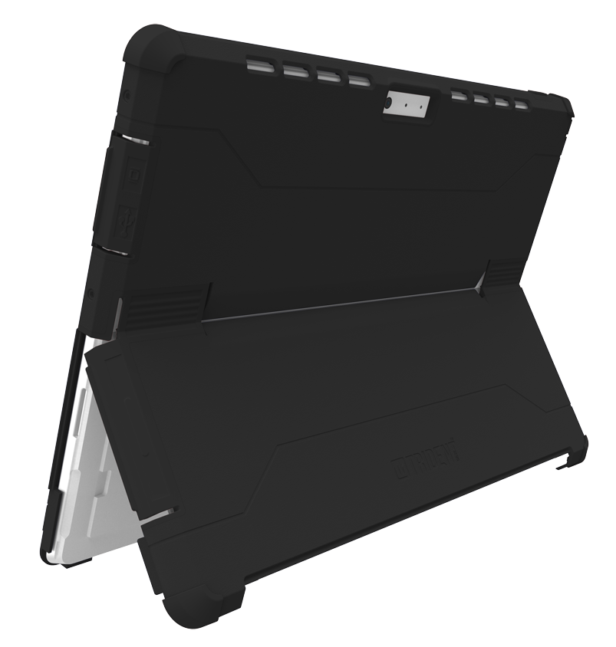
Case with Kickstand – Cannot be Removed from the Device
Pull out the kickstand. Must be careful with case. Do not bend 180 degrees.
$40 charge if missing/broken
No decorations or stickers are allowed on the case
Notes:
Since all defective cases have been replaced over the summer, each case replacement charge will be $40.

Slide 5
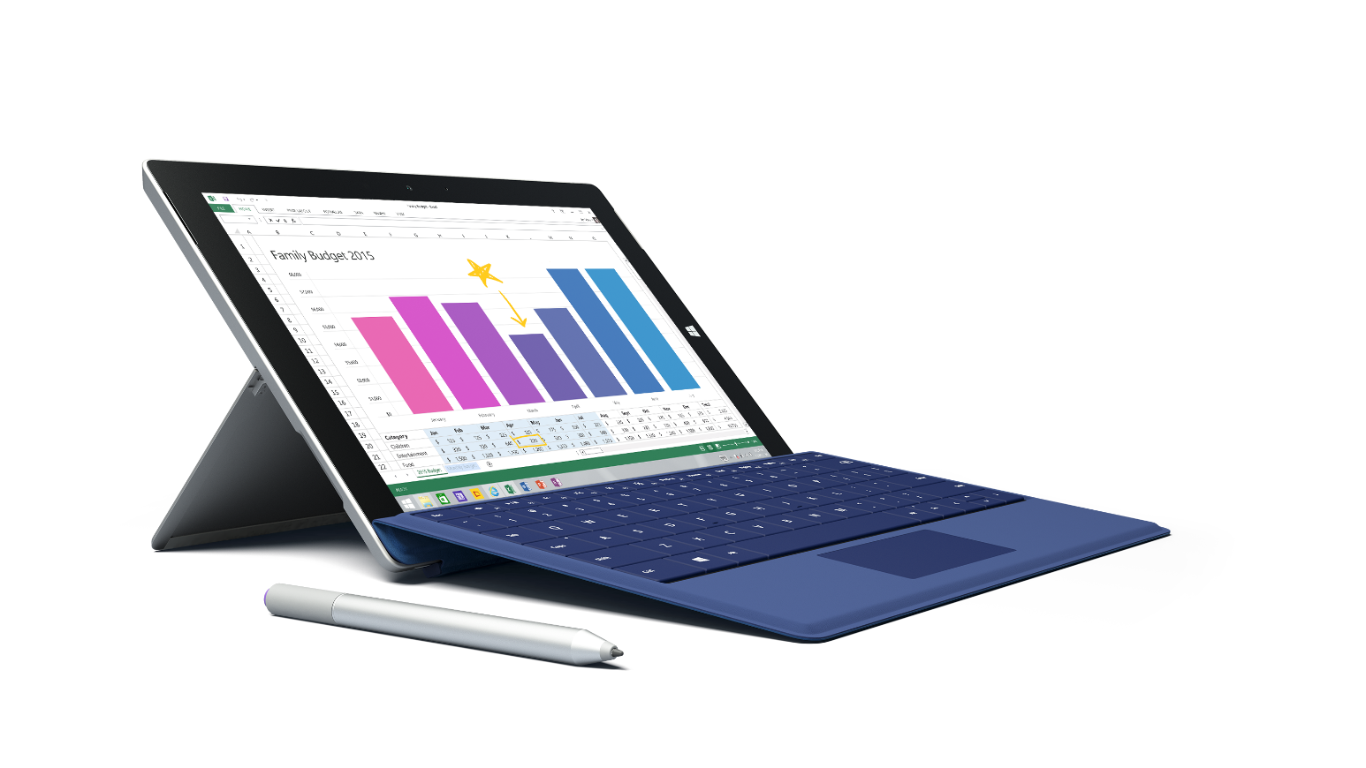
Detachable Keyboard
If keyboard is not working, detach and reattach. If keyword is still not working, restart the device
$130 charge if missing/broken /missing keys
No decorations or stickers are allowed on the case

Slide 6
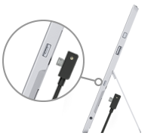
Charging the Surface
Track the battery life with the battery icon on the bottom right
The light on the connector must be facing towards you and on when charging
Power off the tablet entirely at the end of each day to fully charge overnight. Must maintain 50% or more battery. Otherwise, WIFI function may be disabled.
Notes:
Without more than 50% or more battery, the help desk will not be able to troubleshoot any WIFI or network issues.

Slide 7
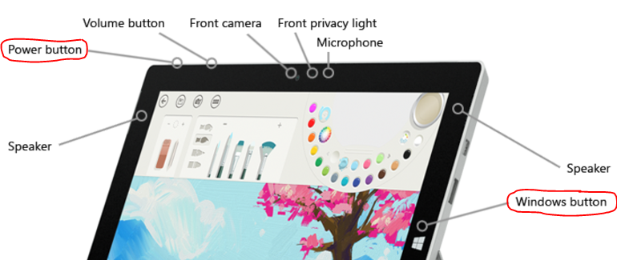
Power on/off the Surface
To power on the device, press the power button on the top left until the word SURFACE comes on.
Click OK for the Acceptable Use Policy.
To power off the device, select the Windows icon on the bottom left corner → Power symbol → Shut Down (sometimes Update and Shut down if an updated is needed).

Slide 8
If You Still Haven’t Completed the Digital Citizenship Assessment
Go to http://bit.do/dHAxx and complete the assessment before asking your teacher whether you can come down to the Learning Studio (media center) or not.

Slide 9
After receiving your device…
Must carefully examine the device and charger:
Cracked screen – must be verified by the teacher before reporting to the media center
Broken charger or case – must be verified by the teacher before filling out this online form (http://bit.do/dHAw8) to avoid any additional charges.
Start up the device until the login screen pops up and then restart the device at least once before logging on.

Slide 10
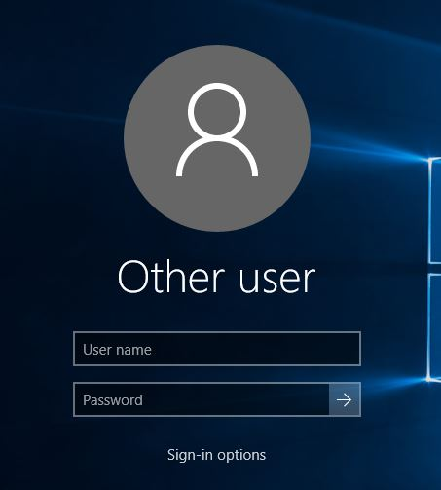
Login (FCSWIFI must be on)
Tap Other User (on the bottom left)
Login with fcboestu\your student number as username and your date of birth (MMDDYYYY) as password

Slide 11
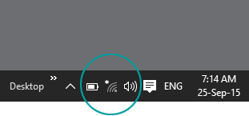
MUST Connect to FCSWIFI Wireless Network
Tap the wireless symbol on the bottom right corner and select FCSWIFI
Enter your fcboestu\your student number as username and your date of birth (MMDDYYYY) as password

Slide 12
Add Tiles to Start Screen
Tap the Windows icon on the lower left corner
Search for each of these apps below and right-click on each one to choose "Pin to Start".
PowerPoint, Word, OneNote, Outlook

Slide 13
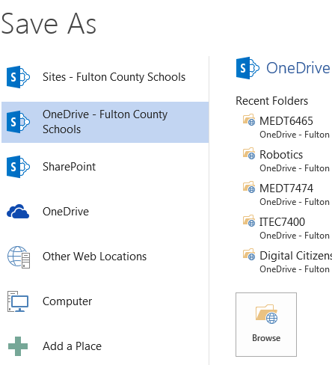
Set Up Microsoft Office Access
Open Microsoft Office
Open a blank document and then type in their full name, class period, and their favorite food.
Tap File → Save As
Look for OneDrive-Fulton County Schools
Notes:
Give students some time to properly set this up.

Slide 14
Set Up Microsoft Office
If OneDrive-Fulton County Schools does not show, click Add a Place. Select Office 365 SharePoint.
Enter your Fulton email address (Student ID@fcstu.org) and password.
Title the document as Testing and then save under OneDrive – Fulton County Schools
Notes:
Give students some time to properly set this up and save the testing document.

Slide 15
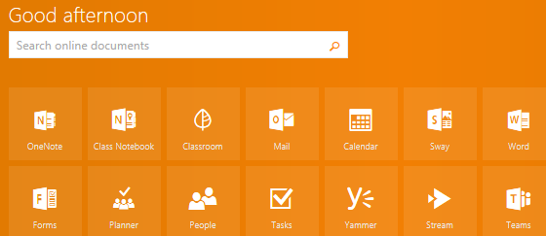
FCS Office 365 – Office Product Online
Access to OneDrive, Word, Excel, and PowerPoint online
Login to Office 365 at portal.office.com
Username is Student ID#@fcstu.org (i.e. 1100123456@ fcstu.org) with your computer password.
Notes:
Give students some time to log into their Office 365 accounts.

Slide 16
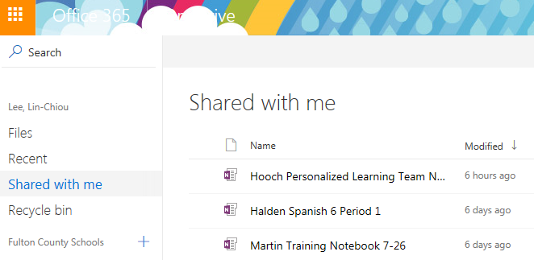
OneDrive through Office 365
Go into OneDrive
Under Files, find the Testing document you just saved
Under Shared with me, find all shared files, including the class notebooks from your teachers
Notes:
Give students some time to access and create documents in OneDrive.

Slide 17
Set up Google Classroom Access
Go to classroom.google.com and click Sign in
Enter StudentID@fcsgaonline.org (i.e. 1100123456 @fcsgaonline.org) with your computer password
Click on the “+” sign on the top right hand corner and then join a class with a class code provided by your teacher.

Slide 18
DO NOT SAVE ANYTHING IN THE DEVICE
Be sure to save all your files either in OneDrive or Google Drive

Slide 19
Pen
Most of your teachers have class sets of Surface pens in their rooms
Students can check out a Surface pen from the Hooch Learning Studio (media center) for the semester
$60 charge if the pen is broken/missing
Learn more about sync your pen and inking ideas
Notes:
For those teachers who have opted to receive class sets of Surface pens, take some time to go over with your students how to use them. Tutorial videos are attached here.

Slide 20
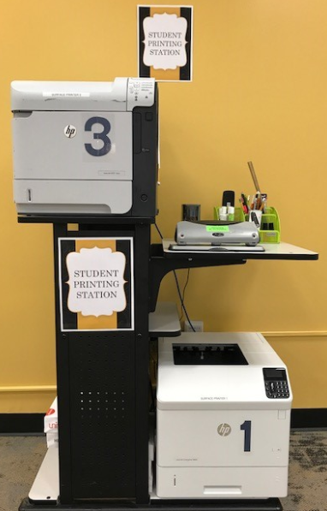
Printing with School-Issued Microsoft Surface @ Hooch Learning Studio
Free black-and-white printing at the Hooch Learning Studio
When printing, look for:
880-MC-Surface-Printer 1
880-MC-Surface-Printer 3

Slide 21
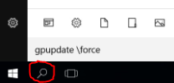
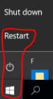
Install these two network printers now…
In the Search bar on the bottom, type gpupdate \force and then hit enter
When the pop-up window finishes updating policy, you will be prompted to restart. Type Y.
If the device does not restart this way, restart by pressing the window icon on the bottom → click on the power icon → select restart.

Slide 22
Check availability before printing
Under Microsoft Office, open a blank document
Tap File → Print
Under the Printer drop down menu, verify that 880-MC-Surface-Printer 1 or 880-MC-Surface-Printer 3 are ready before printing

Slide 23
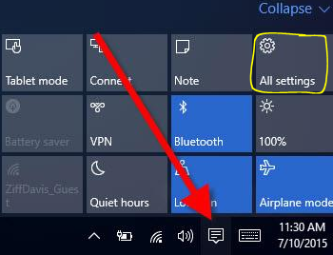
Action Center
The Action Center icon is on the bottom right of the screen
Be sure to “Expand” all tiles within the Action Center
Turn on or off “Battery Saver,” “Brightness,” and “Bluetooth” through the Action Center

Slide 24
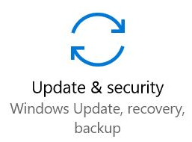
Windows Update
Run Windows Update EVERY WEEK by opening the Action Center → selecting All settings → Update & security → Run Windows Update
When update is complete, be sure to restart the device

Slide 25
Please note that you are not allowed to alter anything else within the device other than what was listed in this presentation.
Please come to the CIA Surface Shop at the Hooch Learning Studio (media center) for additional assistance:
7:45 – 8:15 every morning
4th and 5th period

